Slide 1
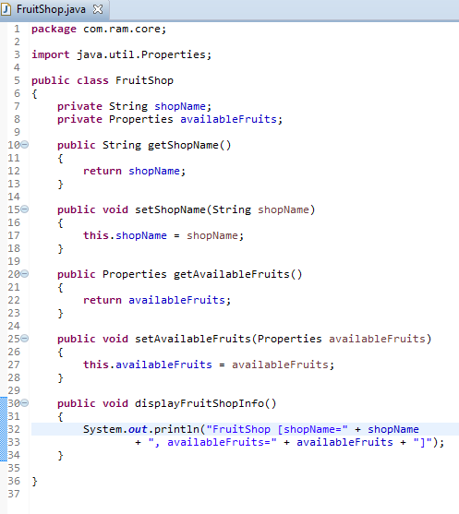
Setter Dependency Injection with Properties

Slide 2
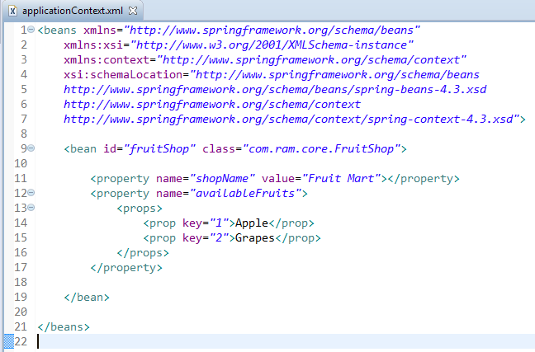
Setter Dependency Injection with Properties
We are providing the information into the bean by applicationContext.xml file.
The property element invokes the setter method.
The props element is used here to define the Properties.

Slide 3
Setter Dependency Injection with Properties
FruitShop
What object to instantiate?
What object to configure and how to configure?
The Spring Container
(ApplicationContext)
applicationContext.xml
FruitShop
Object
FruitShop [shopName=Fruit Mart,
availableFruits={2=Grapes, 1=Apple}]
Create the FruitShop object.
Configure the FruitShop object.
Manage FruitShop object complete life cycle from creation till destruction.

Slide 4
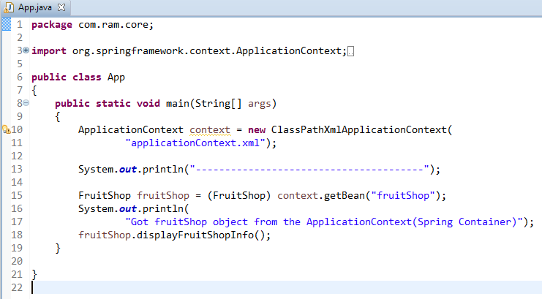
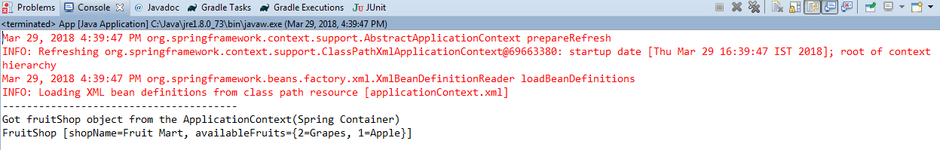
Setter Dependency Injection with Properties

